Slide 1

AmCart
ECOMMERCE

Slide 2
Assumptions
Application will support multiple languages
Responsive design for optimal viewing on various devices
Website anticipates a large user base.
It exclusively supports web applications
Website is expected to experience high traffic

Slide 3

NFR
In compliance with GDPR regulations, sensitive information will undergo masking.
During the sales duration, the application will scale up to meet increased demand
Minimize the application's downtime.

Slide 4
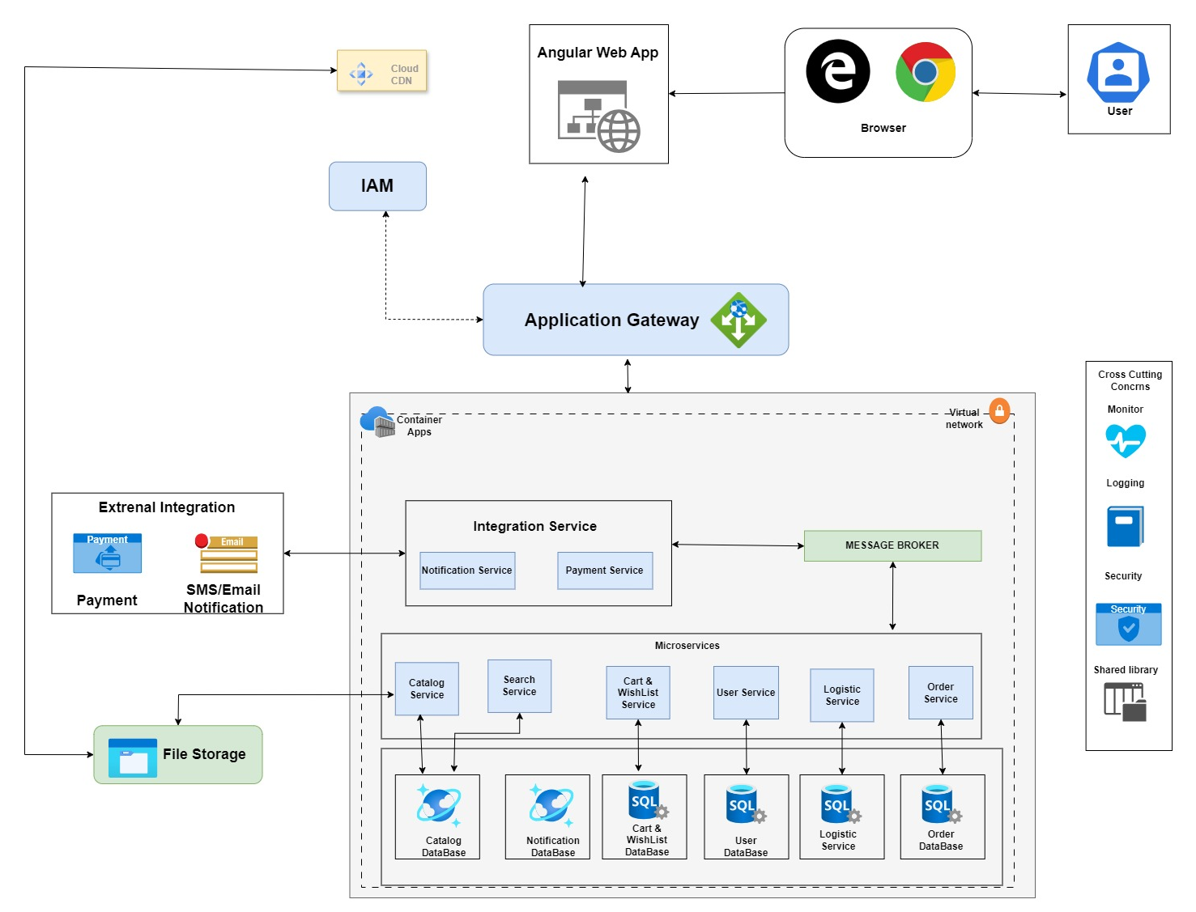
Architecture Diagram

Slide 5
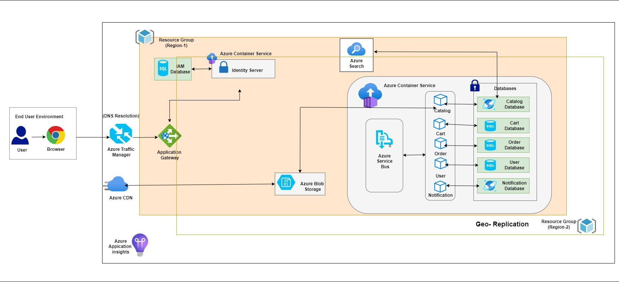
Deployment Diagram

Slide 6
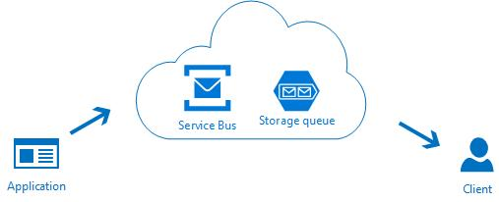
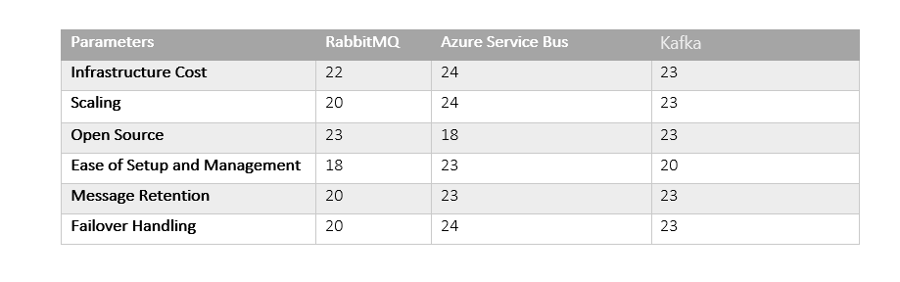
Message Broker
Azure Service Bus

Slide 7
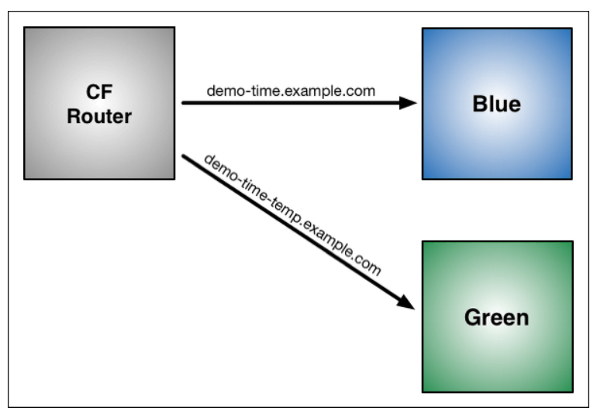
Deployment Strategy
Blue Green

Slide 8

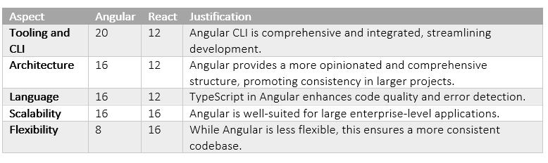
Front End
Angular

